Slide 1

Dhruv r. patodia 5 a electric car,bike,cycle and scooter

Slide 2
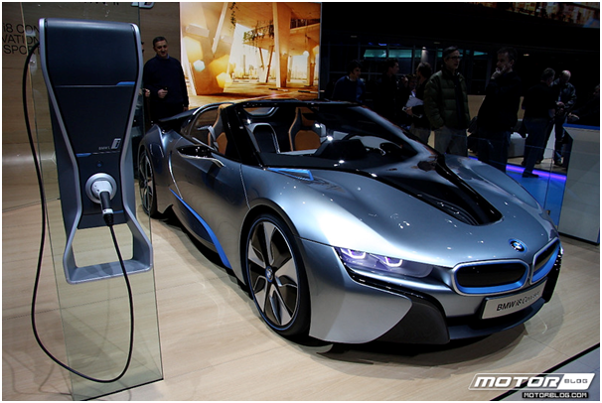
electric car

Slide 3
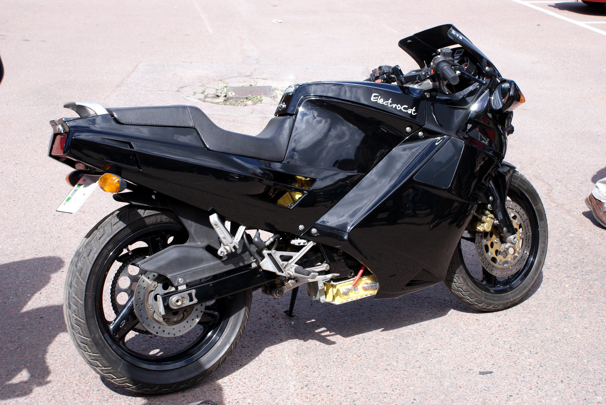
Electric bike

Slide 4
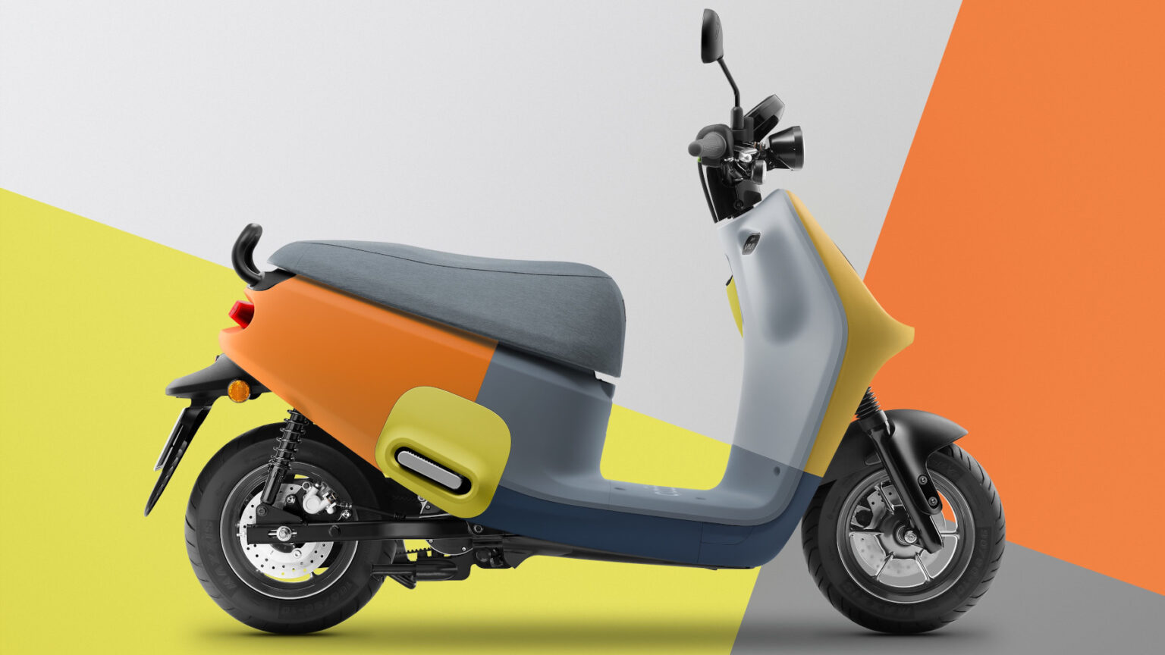
Electric scooter

Slide 5
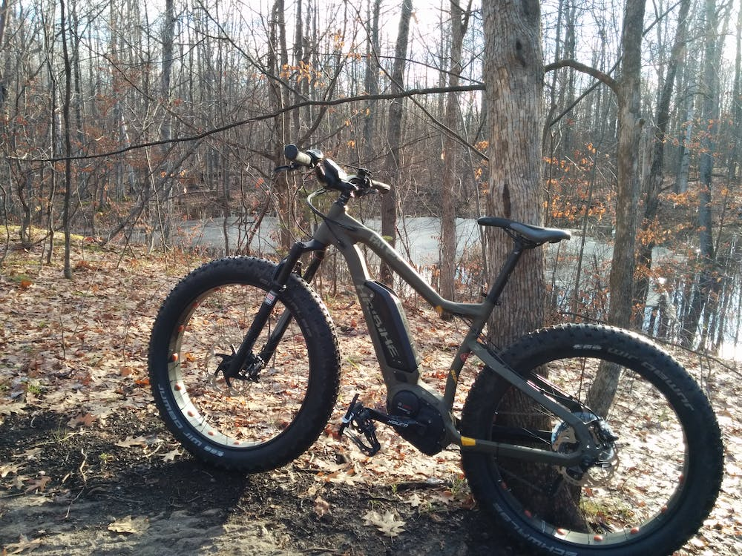
Electric cycle

Slide 6
Thank you

